Slide 1
Assignment 3, Q1:
It is reasonable when the features are conditionally independent given classification, or at least reasonably independent (still works with little dependence). However, if features a strictly correlated and do not cancel each other out, Naïve Bayes assumption do not perform as good. Naïve Bayes can perform surprisingly well even on complex tasks where it is clear that the strong independence assumptions are false. No matter how strong the dependencies among attributes are, Naive Bayes can still be optimal if the they distribute evenly in classes, or cancel each other out.

Slide 2
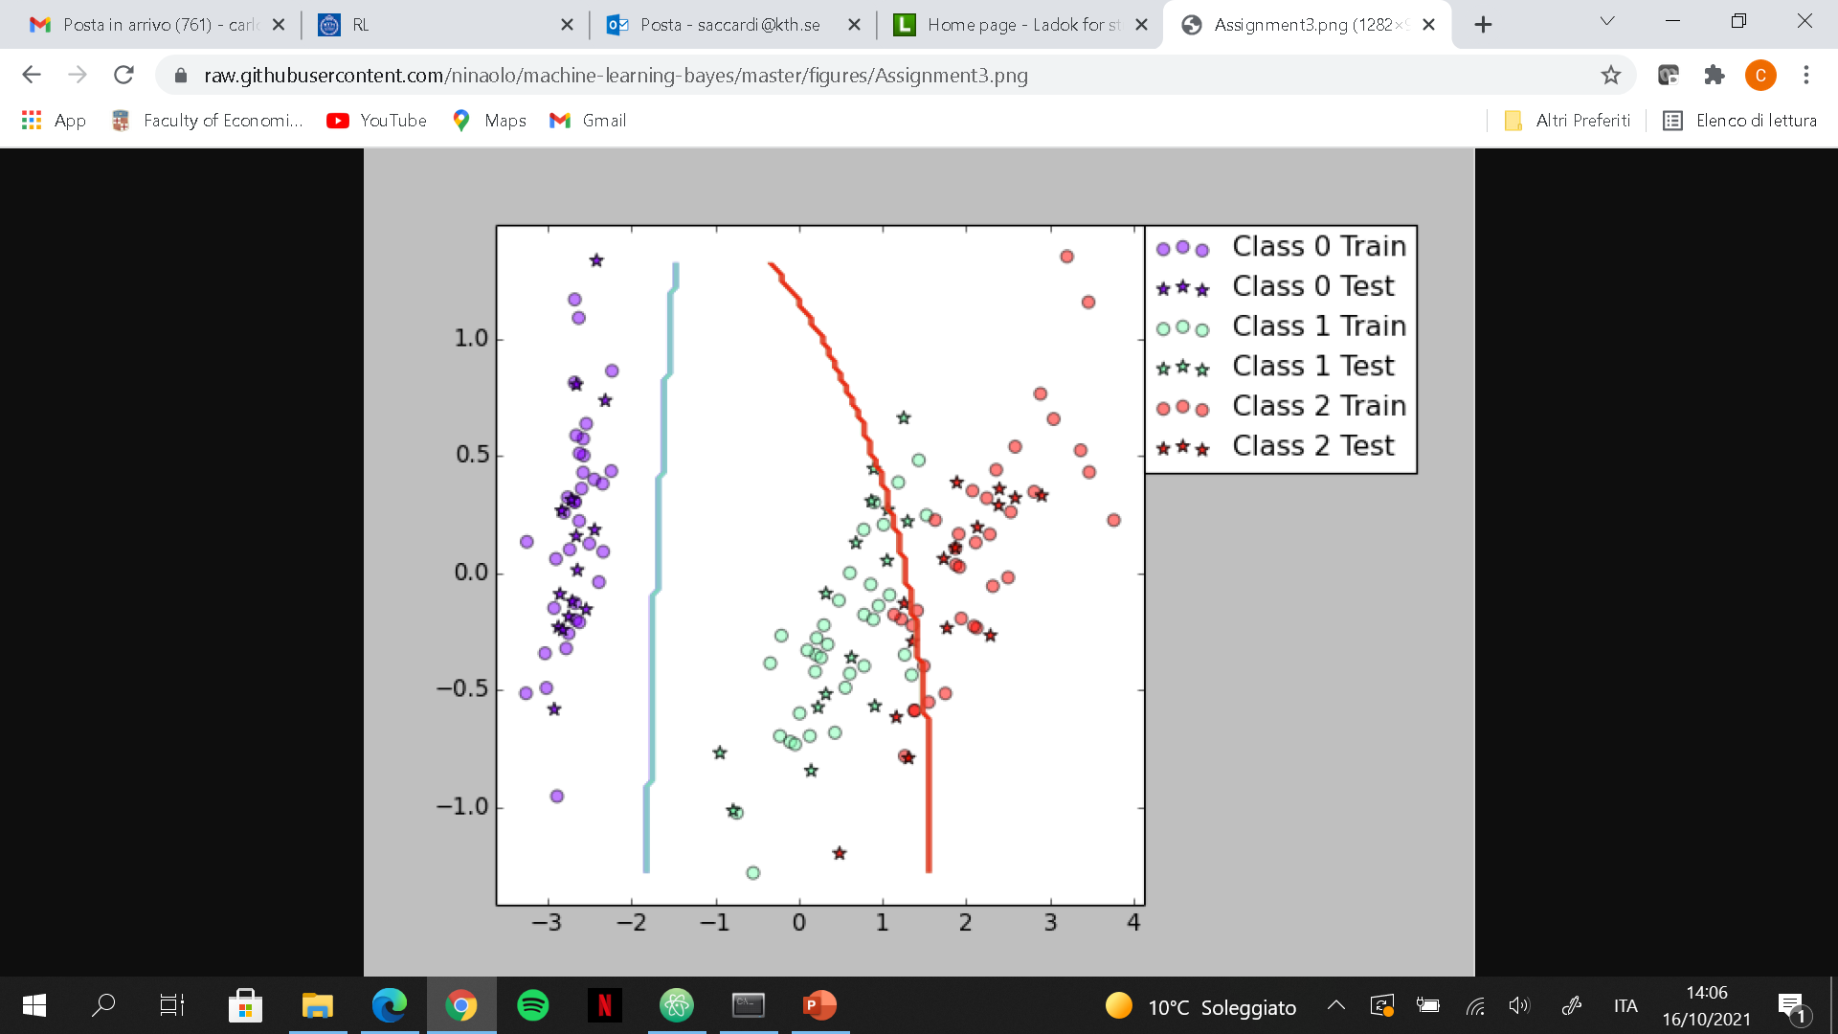
Assignment 3, Q2:
As the plot shows, the decision boundaries are very easy. Thus, to improve the classification performances a more complex boundary could be used. In the Iris dataset the feature consists of 2 attributes describing the characteristics of the Iris (length and width for the Petals and Sepals), one can assume some correlation between the attributes. A linear transformation could be used to try decorrelating the data.

Slide 3
Assignment 5, Q1:
Yes, for the Iris dataset the accuracy improves from 88 to 93.6 and for the vowel dataset it improves from 64.7 to 77.1. The reason why the classification accuracy improves is that the boosted classifier combines multiple weak classifiers and their predictions into a strong classifier with low variance. Since the variability is lower, it will perform better on unseen data.

Slide 4
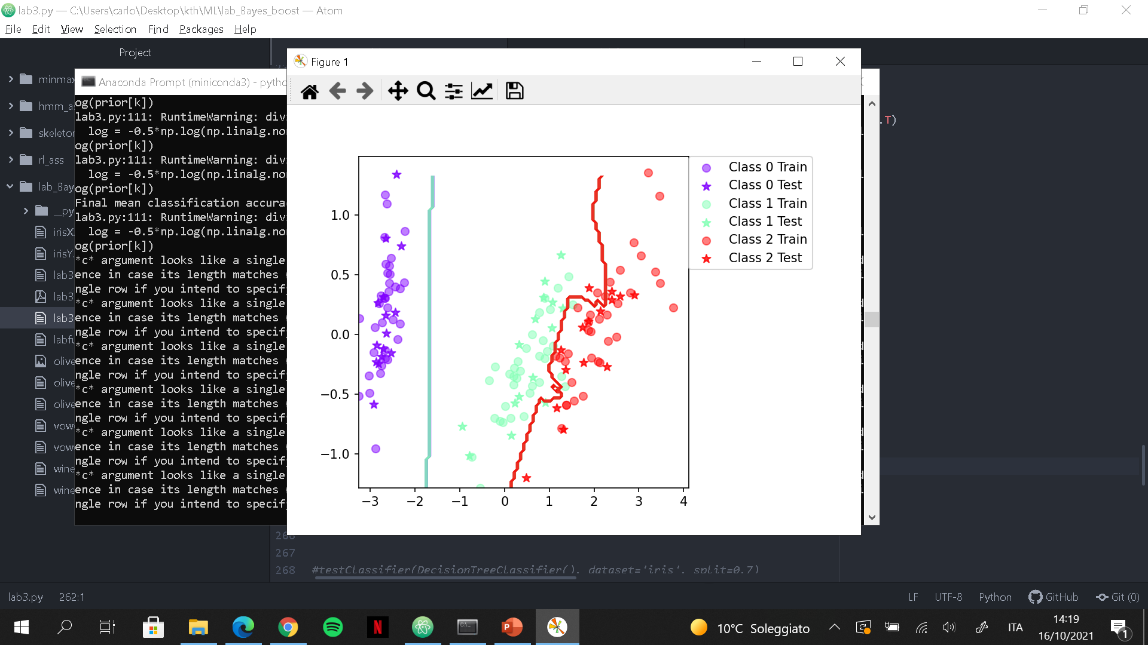
Assignment 5, Q2: The decision boundary for the boosted classifier combines multiple classifiers and results in a more complex boundary that classify the data better.

Slide 5
Assignment 5, Q3:
Yes, because as the decision boundary shows, it can go from a simple decision boundary for a simple model using no boosting to a complex decision boundary when applying boosting.

Slide 6
Assignment 6, Q1:
Yes, for the Iris dataset the accuracy improves from 92.4 to 93.6, while for the Vowel dataset it improves from 64.1 to 86.3. The reason why the classification accuracy improves is that the boosted classifier combines multiple weak classifiers and their predictions into a strong classifier with low variance. Since the variability is lower, it will perform better on unseen data.

Slide 7
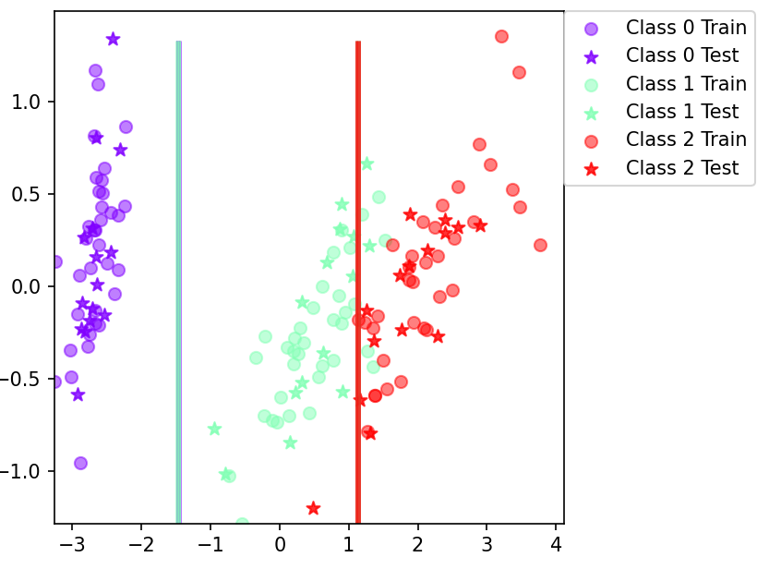
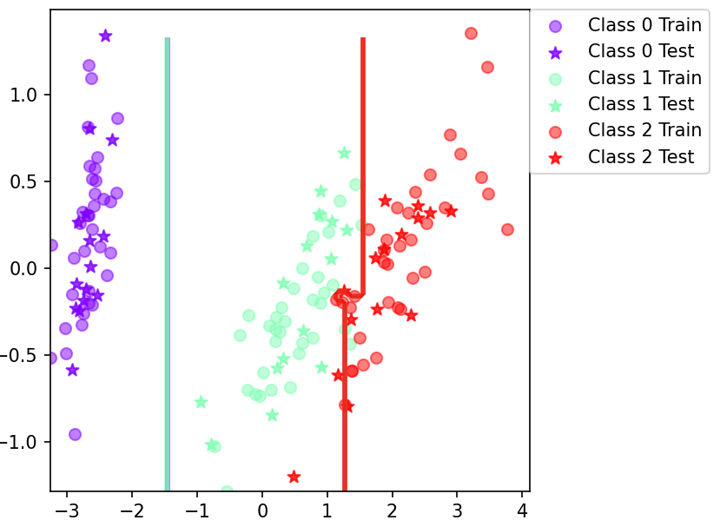
Assignment 6, Q2: The decision boundary for the boosted classifier combines multiple classifiers and results in a more complex boundary that classify the data better.

Slide 8
Assignment 6, Q3:
Yes, because as the decision boundary shows, it can go from a simple decision boundary for a simple model using no boosting to a complex decision boundary when applying boosting.

Slide 9
Assignment 7:
We would pick a boosted classifier since they are less variable, more robust, and thus they perform better on unseen data. The choice between boosted tree or boosted Naïve Bayes depends on the problem. Decision tree treat outliers better since the partitioning happens based on the proportion of samples within the split ranges and not on absolute values. Moreover, decision tree deals irrelevant inputs extremely well since they implicitly perform feature selection (top nodes are the most important features). On the other hand, Naïve Bayes is simple and easy to implement. It doesn't require as much training data. It handles both continuous and discrete data and it is highly scalable with the number of predictors and data points.

